Slide 1
Programmable Logic Devices (PLD)
CSE 4205: Digital Logic Design
Aashnan Rahman
Junior Lecturer
Department of Computer Science and Engineering (CSE)
Islamic University of Technology

Slide 2
01
PLD

Slide 3
Introduction
With the advent of large-scale integration technology, it is feasible to fabricate large circuits within a single chip
  A consequence – Programmable Logic Devices (PLD)
    A kind of LSI
  A combinational circuit to implement a set of Boolean functions
Advantages of PLDs:
    Reduced space requirements
    Reduced power requirements
    Design security
    Compact circuitry (Higher density)
    Short design cycle – [Analysis, Design, Development, Testing, Deployment]
    Higher switching speed (toggling speed)
    Low production cost for large quantity production

Slide 4
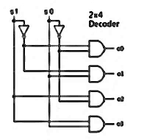
PLD
Normally Boolean functions are expressed by sum of product forms or sum of required minterms
  A decoder can be used to generate 2^{n} minterms for n inputs
    One or more OR gates are required to generate the expected function
  IC packages (PLDs) are developed with larger integration of decoders and OR gates to generate one or more required outputs at a time
    Advantage: Reduce the broad space, interconnections and power consumption
Specially they are used as a memory device
  In spite of being combinational circuit devices

Slide 5
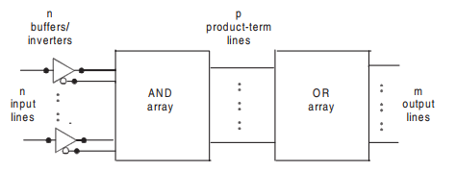
General Structure of PLD
Product term production
Sum term production

Slide 6
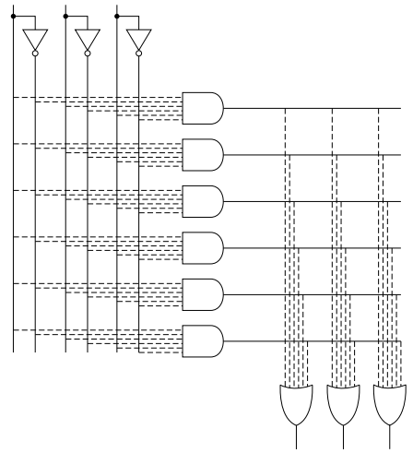
Internal Structure of PLD

Slide 7
PLD Classification
Read Only Memory (ROM)
Programmable Logic Array (PLA)
Programmable Array Logic (PAL)

Slide 8
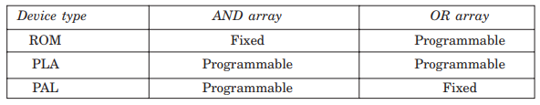
PLD Classification

Slide 9

Concept of Programmable Array
In a programmable array, the connections of gates are flexible
  To implement a programmable gate, a fuse link is employed
  Example: a programmable input to an AND gate
    Some of the fuses are blown out to achieve the desired output of the gate

Slide 10
02
Read Only Memory (ROM)

Slide 11
ROM
Common Notation – 2^{n} x m ROM
  n input lines and m output lines
    2^{n} intermediate ANDed (i.e. product/minterm) terms which are fixed
    m outlines lines are programmable
  Also, this notation is considered as total number of bits stored.
  Also, 2^{n} denotes the total number of addresses and m denotes the total number of bits per word
  A two level logic representation in sum of minterms form

Slide 12
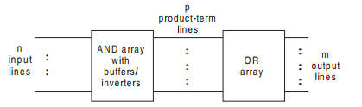
ROM

Slide 13
ROM
Once a pattern is established, it would not be erased even if power supply is off (Non- volatile)
Bit combination of n input variables are called addresses
  Each address combination (one of the minterm) is connected with required output lines (m bit) to make a specific word – n-bit long address
  Each bit-combination of output lines is called a word – m-bit long word
Example:
  32x8 ROM = 2⁵x8 ROM = 5 input variables, 32 addresses and word length = 8

Slide 14
ROM with Decoder
A decoder could be used to implement a ROM
  Decoder – a combinational circuit that generates 2^{n} number of minterms from n input variables
    Each minterm then is applied to required number of OR gates using fusible links which could be blown up selectively as per requirement (shown in logic diagram)
Decoder

Slide 15
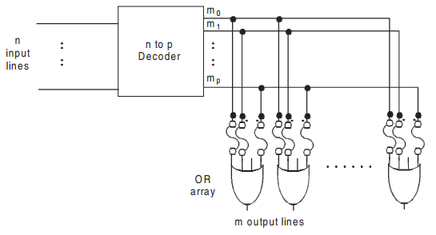
2^{n} x m ROM Logic Diagram

Slide 16
ROM Applications
Basically to design different components of a digital computer system like:
  Complex combinational circuit
  Code conversion
  Bit pattern generation for characters
  Multipliers
  Look up table
Especially they are used as a multiple-output combinational circuit with same set of inputs
Storage of a fixed bit pattern – memory storage ROM
Also, used with microprocessors and microcontrollers

Slide 17

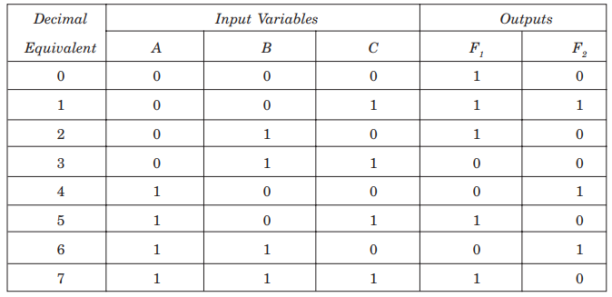
ROM Example
a 2³x2 or 8x2 ROM is required.
Program table or truth table for ROM:

Slide 18
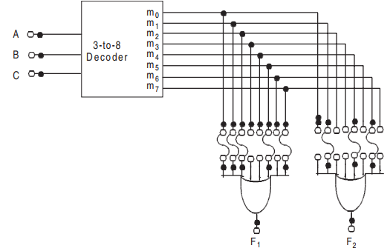
ROM Logic Diagram

Slide 19
ROM Types
Types of programming:
  Mask Programming:
    Done by manufacturer
  Field Programming:
    Done by user by means of following certain procedures and having programming equipment
Types of ROM (field programmable):
  PROM – programmable only once
  EPROM – erasable with UV light chamber
  EEPROM – resettable to the original state of 1s and 0s with a special electrical signal

Slide 20
02
Programmable Logic Array(PLA)

Slide 21
PLA
Motivation:
  A combinational circuit may contain don’t care conditions which will never occur
    A waste of memory considering don’t cares as valid minterms
    Example: Code conversion from BCD to Excess 3 where 6 addresses will not be used for a 16x4 ROM
      A waste of 6x4 bit locations
  PLA (kind of LSI) is more economical to use where don’t care cases are excessive

Slide 22
PLA
PLA doesn’t produce all minterms like ROM or decoder
  Rather some essential AND gates with buffer/inverters are used to generate some required product terms
    These product terms are used to realize the expected output functions in turn.
Here, Boolean functions are implemented in sum of products form rather than sum of minterms form
The AND and OR gates are fabricated with fusible links inside the PLA
  All inputs to the AND and OR gates have fusible links
  Even the outputs have inverter (NOT gate) with fusible links to be available both in F and F’ format
  The required functions are realized opening (blowing off) required links

Slide 23
PLA
Common notation: n x p x m
  n = number of inputs
  p = number of product terms
  m = number of outputs (or sum terms)
Total number of programmable links = 2n x 2p x 2m
The basic difference between ROM and PLA is in the number of the product term
  i.e. 2^{n} (ROM) >> p (PLA)
  e.g. 16 x 48 x 8 PLA. Here the number of product term is drastically reduced

Slide 24
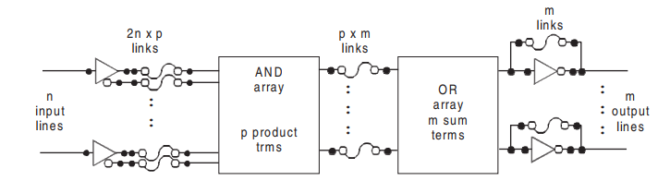
PLA Block Diagram

Slide 25
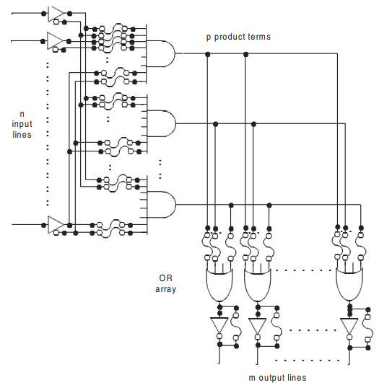
PLA Logic Diagram

Slide 26
PLA Types
Types of programming:
  Mask programming
    User must provide the PLA program table to the manufacturer
  Field programming
    User can program it by means of certain procedures and equipment

Slide 27
PLA Implementation
Constraint: All minterms are not present in the AND array like ROM
So, SOP is more preferred over SOM [standard form over canonical form]
Some degree of simplification of Boolean functions is required to meet the required number of product terms
Extra intelligence is required to choose between F and F’
  So that the number of product terms does not exceed the number of AND gates

Slide 28

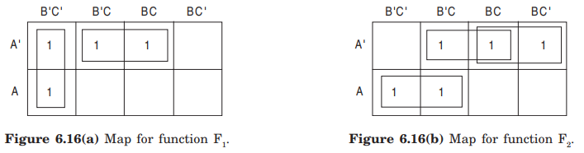

PLA Example
Example: Use a 3 x 4 x 2 PLA to implement the following Boolean expressions
To get required and reduced product terms, simplified expressions are:

Slide 29
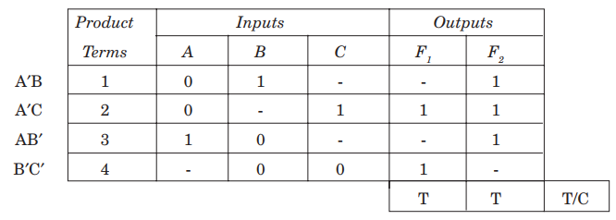
PLA Example
PLA program table
T = in its original form, inverter is blown up
C = in its complement form, inverted is used

Slide 30
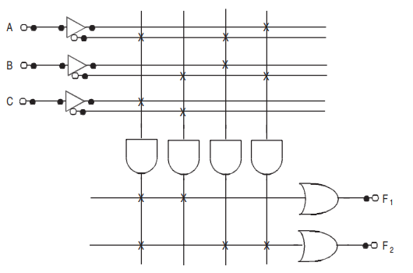
PLA Implementation
Internal connections of PLA with PLD notation:

Slide 31
03
Programmable Array Logic (PAL)

Slide 32
PAL
General structure of PAL is very similar to PLA
  But, only difference between these is in a PAL device, only AND gates are programmable whereas OR gates are fixed by manufacturer.
    So, PLA is less expensive, more flexible and more easier than PAL

Slide 33
PAL
External inputs are connected with the AND gates with programmable links
  Whereas, the output of AND gates are fed to OR array with fixed connections
All the AND outputs are not fed to all OR gates
  Rather, few AND outputs are connected to an OR gate based on the manufacturer’s direction (Figure shown)
Similar n x p x m notation for PAL as PLA:
  n = number of inputs
  p = number of product terms
  m = number of outputs (or sum terms)

Slide 34
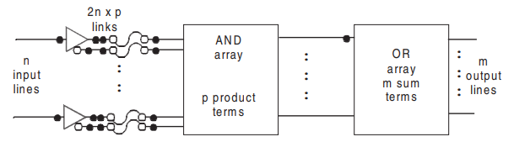
PAL: General Structure

Slide 35
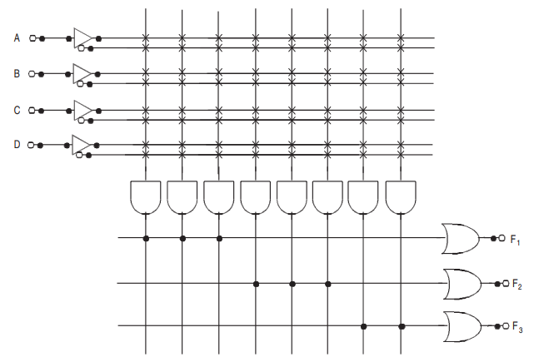
Generic 4 x 8 x 3 PAL

Slide 36
Other PLDs
Registered PAL devices
  For sequential circuits
Generic Array Logic Devices (GAL)
Field Programmable Gate Array (FPGA)

Slide 37
04
ALU

Slide 38
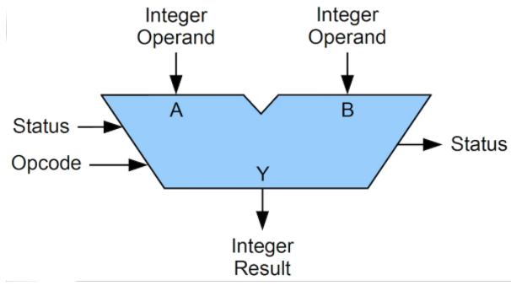
ALU as Logic Device
ALU is a part of CPU that performs the calculation and condition testing
  Considered as fundamental building block of CPU

Slide 39
ALU
Consists of millions of transistors
Performs:
  Arithmetic operations – Add, subtract, …
  Logical operations – AND, OR, Rotate, Shift, …

Slide 40
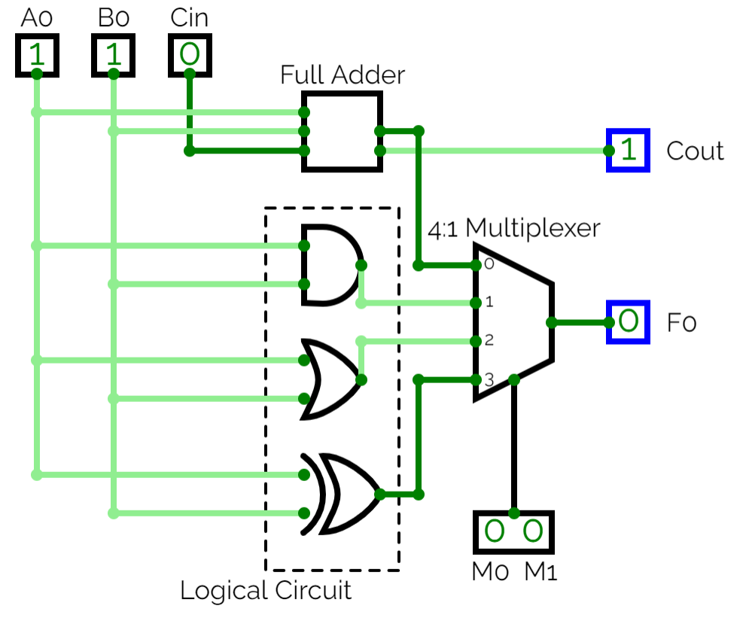
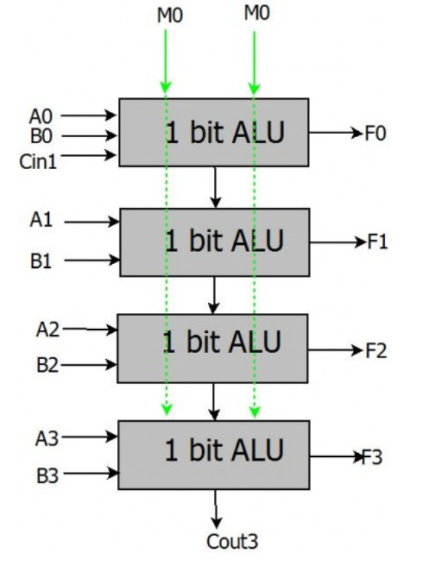
Example
Circuit Diagram
of 1-bit ALU
Block Diagram
of multiple 1-bit ALUs

Slide 41
Resources
Note 1
Resource 1

Slide 42
Thank You !!
Feel free to ask any questions

